Slide 1
Quality Improvement Project:
Improving management of diabetic ketoacidosis within NuTH critical care
Sarah Parry
Foundation Year 2 Doctor

Slide 2
Introduction
Whilst working within Wd38 critical care, I identified a lack of clarity and consistency of DKA management due to the use of two conflicting DKA guidelines within the department.

Slide 3
The Aim:
To improve accuracy and consistency of diabetic ketoacidosis (DKA) management within ward 38 critical care.

Slide 4
Methods
Comparison of NuTH guideline and National JBDS guideline.
Performed retrospective case reviews of DKA admissions to Wd38 over 4-week period (29/01/21-26/02/21).
Alongside Dr Varghese, critical care trust grade, I completed a survey of Wd38 critical care residents regarding their current practice when managing DKA and their opinions on the existing NuTH DKA guidelines.
I presented DKA case reviews and results of Wd38 resident survey at critical care MDT meeting and facilitated discussion about how to improve NuTH critical care management of DKA.
Alongside Dr Paul and Dr Gray, critical care consultants, and fellow F2 doctor, Dr Reaich, we created a first draft of a new NuTH guideline entitled “Management of glycaemic emergencies within critically ill adults”.
Notes:
This document is a detailed 25 page guideline explaining the management of DKA, HHS and hypoglycaemia within NuTH critical care. We created guideline summary sheets and monitoring charts which condense the information into easy-to-read and printable double-sided A4 sheets for each condition.

Slide 5
Results:
Guideline Comparison
NuTH Guidelines:
JBDS National Guideline
Management is driven by blood glucose rather than ketones
Initial fixed rate insulin infusion (FRIII) is standard at 6units/hr and then doubled to 12units/hr if no fall in BM in first 2hours
Once BM falls to <13 a GKI with 24units is commenced and 20mmol/l KCl
Management is driven by ketones and prevention of hypoglycaemia
Initial FRIII is body weight calculatedas 0.1unit/kg/hr with a maximum starting of 13units/hr
Once BM falls to <13 dextrose is commenced through a separate bag run through the same access point as FRIII insulin
Once ketones fall to <0.6 FRIII is exchanged for VRIII (“sliding scale”)
Notes:
GKI with 24units = 3.8units/hr
GKI with 16units = 2.6units/hr
GKI with 12units = 1.9

Slide 6
Results:
Retrospective case reviews
N=4 between 29/01/21-26/02/21
N=3 managed as per “NuTH Protocol”
N=1 managed as per “JBDS National Protocol”
75% of cases involved insulin/glucose prescription or management errors

Slide 7
Results:
Retrospective case reviews
“We couldn’t work out what the management plan had been exactly”
“Exactly what happened I didn’t really understand, but it was clear after handover the patient was deteriorating.”
“It was very unclear what had happened overnight as documentation was not thorough”
“I found the NuTH guideline difficult to follow and as BMs were rising despite increasing insulin in GKI. As it was OOH, I felt it was safer to prescribe a regime I was comfortable with so I converted to that recommended in national guidance”
Notes:
Incorrect fluids both using NuTH

Slide 8
Results:
Survey of Wd38 Residents
Number of residents
Notes:
Survey of current practices and beliefs held Wd38 junior doctors and advanced critical care practitioners (ACCPs) that have managed a DKA case within NuTH (n=10)
60% following NuTH DKA protocol; 30% following national protocol; 10% not following a protocol.

Slide 9
Results:
Survey of Wd38 Residents
Opinions from these residents regarding existing NuTH DKA guideline included:
“there needs to be consistency and clear guidance”
“we need a better protocol”
“please keep GKI for the wards”
“very confusing”

Slide 10
Results:
Critical Care MDT Discussion
MDT discussion held on 10/03/21 with critical care consultants, critical care residents and diabetes consultant and diabetic specialist nurses.
Outcome 1: To create a new critical care DKA guideline which will no longer include GKI but instead echo that of JBDS National Guideline.
Outcome: To include this DKA guideline as part of a larger document also covering management of all glycaemic emergencies: i.e. DKA, HHS and hypoglycaemia.

Slide 11
Results:
Creation of the Guideline
Alongside Dr Paul and Dr Gray, critical care consultants, and fellow F2 doctor, Dr Reaich, we created a new NuTH guideline entitled “Management of glycaemic emergencies within critically ill adults”.
This document is a detailed 25page guideline explaining the management of DKA, HHS and hypoglycaemia within NuTH critical care.
We created guideline summary sheets and monitoring charts which condense the information into easy-to-read and printable double-sided A4 sheets for each condition.
Notes:
We have chosen to use national protocol

Slide 12
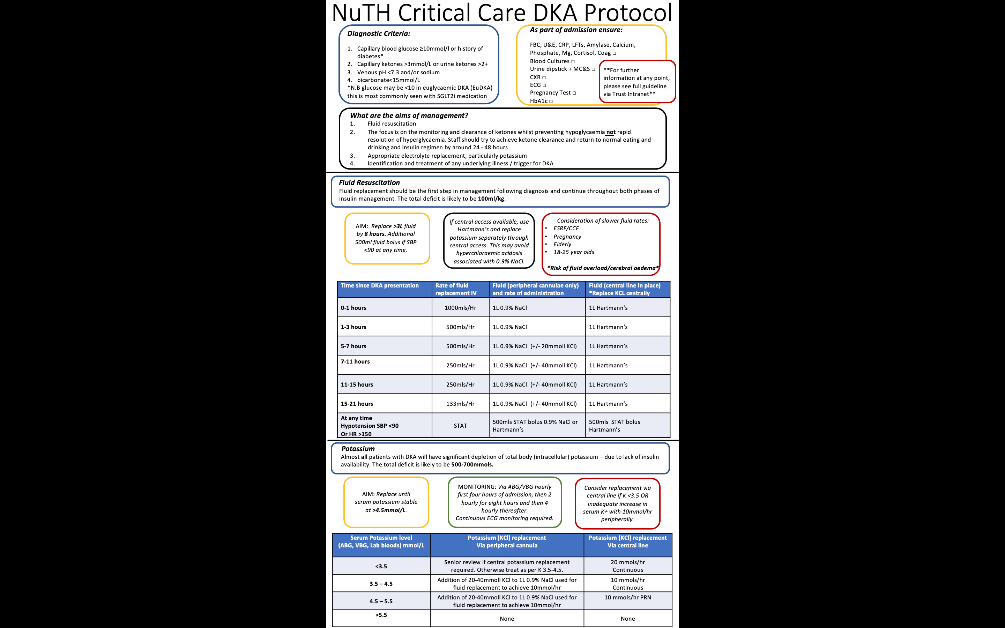

Slide 13
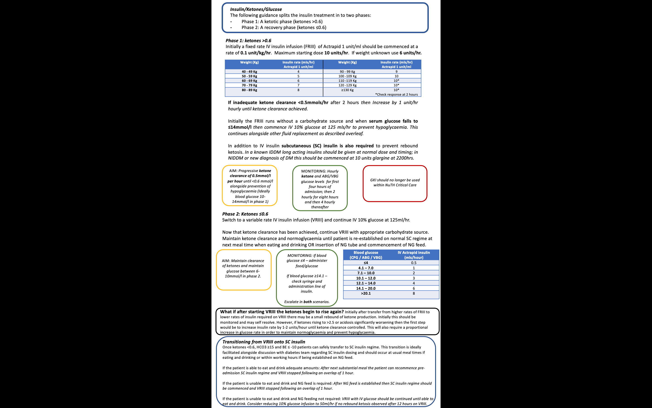

Slide 14
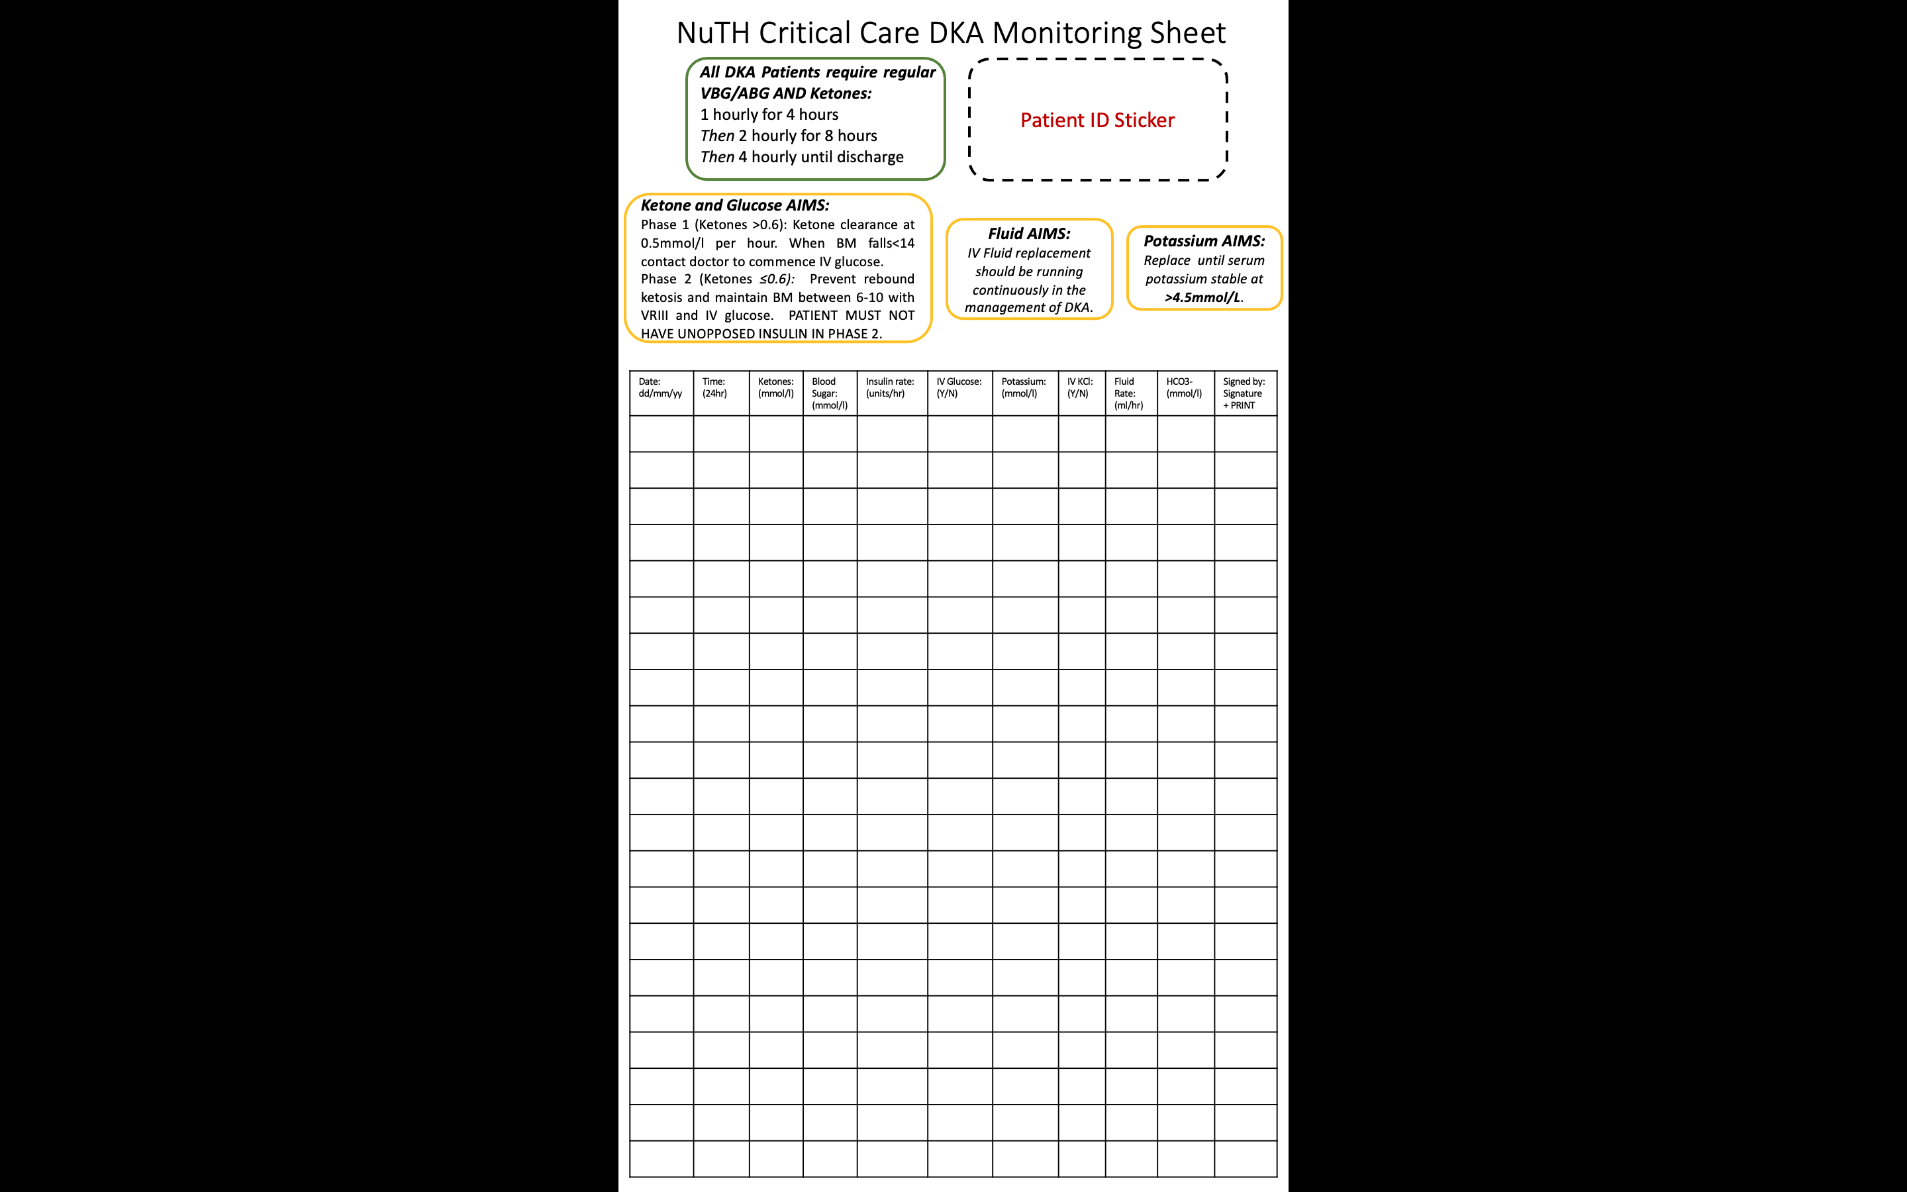

Slide 15
Next Steps
Await feedback from NuTH diabetic team
Wd38 resident and nursing staff focus group
Implementation and education drive with NuTH critical care
Repeat retrospective case reviews of DKA admissions after implementation of guideline
Repeat survey of Wd38 junior doctors and advanced critical care practitioners (ACCPs) after implementation of guideline

Slide 16
Conclusion
As an F2 junior doctor I identified a lack of clarity and consistency of DKA management due to the use of two conflicting DKA guidelines within the department.
I have addressed this by analysing existing DKA guidelines and clinical practice, discussing this with colleagues and then creating a detailed and well thought out guideline for NuTH critical care management of DKA (as well as HHS and hypoglycaemia).
The largest limitation of this quality improvement project is that the guideline has not yet been implemented into clinical practice however this is expected in coming months.

Slide 17
With Thanks To
Dr Arun Varghese, critical care trust grade
Dr Calum Reaich, foundation year 2
Dr Barry Paul and Dr Lewis Gray, critical care consultants

Slide 18
Question Time

